Slide 1
3D-UNET and CNN based Hybrid Architecture for Segmentation and Classification of Brain Tumor

Slide 2
Abstract
Early detection and diagnosis of a brain tumor enhance the medical options and the patient’s chance of recovery. Magnetic resonance imaging (MRI) is used to detect and diagnose brain tumors. However, the manual identification of brain tumors from a large number of MRI images in clinical practice solely depends on the time and experience of medical professionals. This paper aims to design an efficient framework for brain tumor segmentation and classification using transformer techniques. The study employs the 3D-UNet model for the volumetric segmentation of the MRI images, followed by the classification of the tumor using CNN. The loss and precision diagrams are presented to establish the validity of the models. The performance of proposed models is measured, and the results are compared with those of other approaches reported in the literature. It is found that the proposed work is more efficient than the state-of-the-art techniques.

Slide 3
BRAIN TUMOR
A brain tumor is a growth of cells in the brain or near it. Brain tumors can happen in the brain tissue. Brain tumors also can happen near the brain tissue.
Nearby locations include nerves, the pituitary gland, the pineal gland, and the membranes that cover the surface of the brain.

Slide 4
Existing Algorithms for segmentation
Existing algorithms used for segmentation are
Watershed algorithm
K-means Clustering
Gray level thresholding
Region growing
Fuzzy c-means clustering
Such existing techniques are very complex and having very high run time complexity..

Slide 5
Limitations or drawbacks
Manual will take time and cost
ML algorithm : accuracy is less

Slide 6
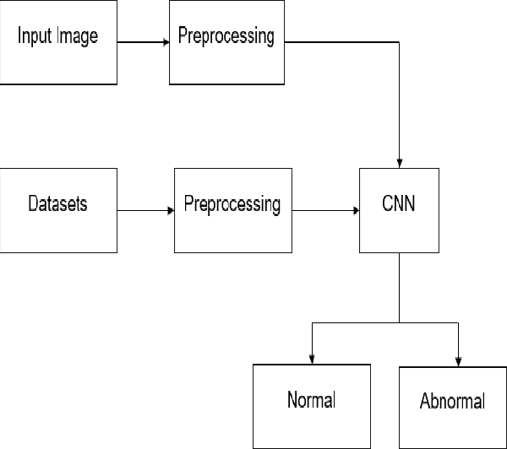
Proposed Method
CNN
Stage 1
Stage 2
Stage 3

Slide 7
Transformers
A model that uses a transformer architecture to classify images.
It works by splitting images into tokens and using transformers to learn relationships between the tokens.
Algorithms used:
Segmentation : 3D UNET [to get the tumor region/location]
Classification : CNN[type of tumor]

Slide 8
Advantages :
Less cost and time is required
Accuracy is higher
Application is user friendly

Slide 9
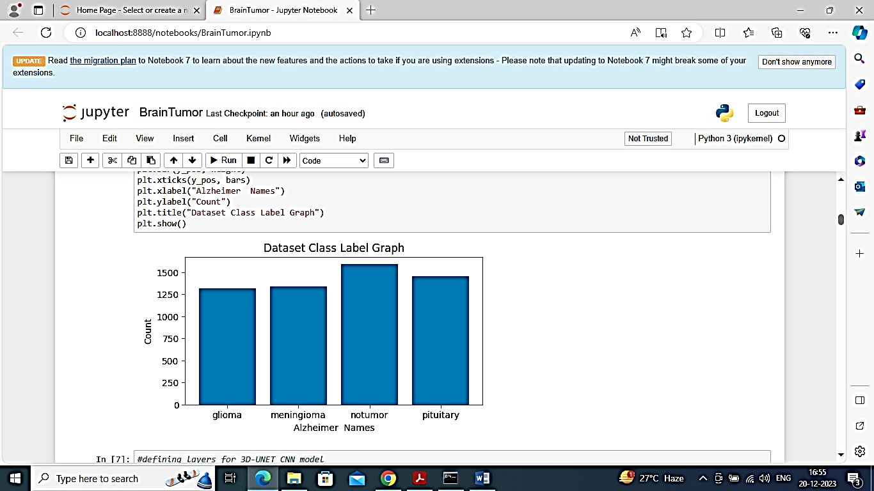
Results
Fig. Dataset class Label Graph

Slide 10
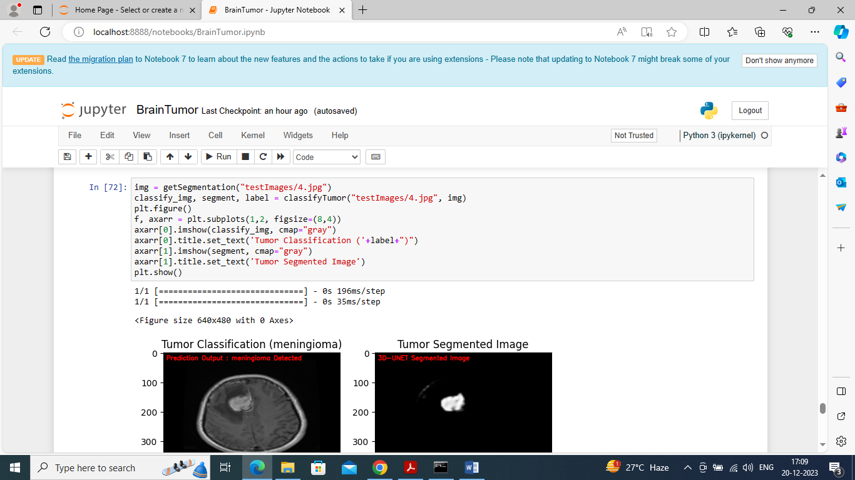
Results
Fig. Dataset class Label Graph

Slide 11
SOFTWARE AND HARDWARE REQUIRMENT
4.1 HARDWARE REQUIREMENTS:
• System : Pentium Dual Core.
• Hard Disk : 120 GB.
• Monitor : 15’’ LED
• Input Devices : Keyboard, Mouse
• Ram : 4 GB
4.2 SOFTWARE REQUIREMENTS:
• Operating system : Windows 10
• Coding Language : python
• Tool : Python
• Database : Brain MRI scan dataset
• Frontend : GUI (tkinter library in python)

Slide 12
Conclusion
In this paper, a system for automatic detection of brain tumor detection from BRATS dataset using UNET and CNN with python software.

Slide 13
References
[1] G. Alain and Y. Bengio, "What regularized auto-encoders gain from the data making allotment," J. Mach. Learn. Res., vol. 15, no. 1, pp. 3563–3593, 2014.
[2] M. R. Avendi, A. Kheradvar, and H. Jafarkhani, "A solidified significant learning and deformable-model approach to manage totally customized division of the left ventricle in heart MRI," MedIA Image Anal., vol. 30, pp. 108–119, May 2016.
[3] M. R. Avendi, A. Kheradvar, and H. Jafarkhani, "Modified division of the right ventricle from heart MRI using a learning-based system," in Magnetic Resonance in Medicine. New York, NY, USA: Wiley, Feb. 2017, doi: 10.1002/mrm.26631.
[4] W. Bai et al., "A bi-ventricular cardiovascular guide book worked from 1000+ significant standards MR pictures of sound subjects and an examination of shape and development," MedIA Image Anal., vol. 26, no. 1, pp. 133–145, 2015.
[5] W. Bai et al., "A probabilistic fix based name blend model for multiatlas division with selection refinement: Application to cardiovascular MR pictures," IEEE Trans. Medication. Picture. vol. 32, no. 7, pp. 1302–1315, Jul. 2013.

Slide 14


